Slide 1
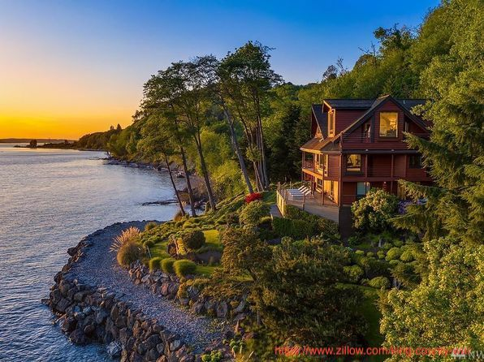
King County
A preliminary analysis of House Prices
By: Christian Robledo

Slide 2
What will you hear today?
Which house types with which features influence the Price
When is a good moment to invest / sell
Other recommendations extracted from the analysis

Slide 3

What are we looking at exactly ?
Area House | 320 ft²-13450 ft²
Lot Area | 520 ft² - 1.6M ft²
Price range | 78k- 7 M
Waterfront Houses | Around 150
Price range Waterfront | 285k - 7M

Slide 4
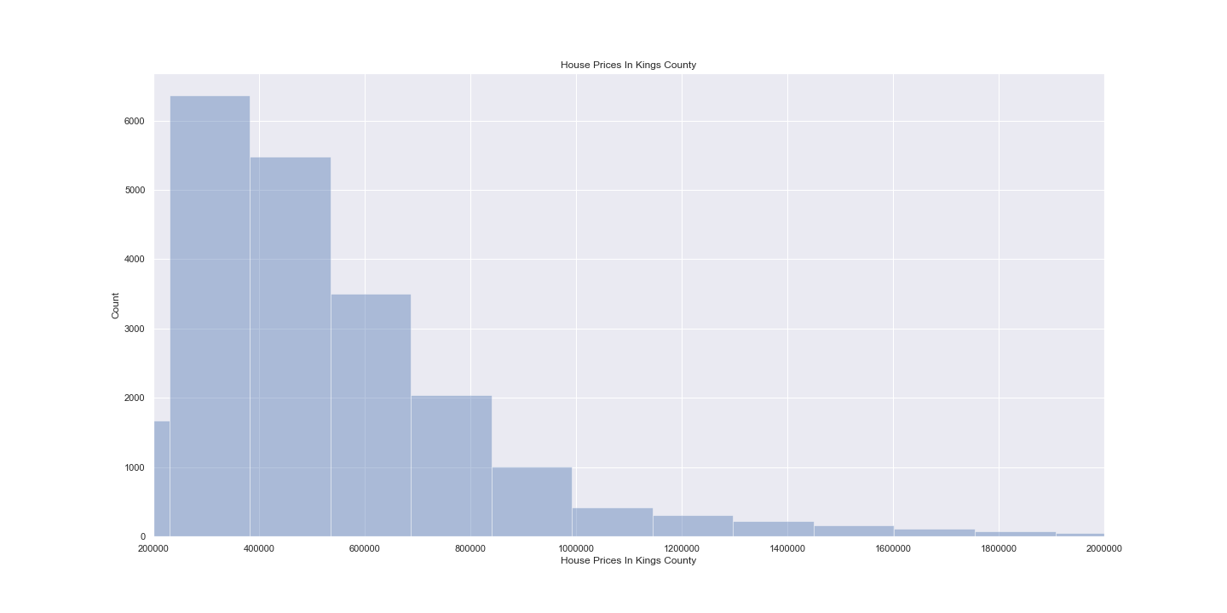
Most Houses Prices between: 300K-1.0M

Slide 5
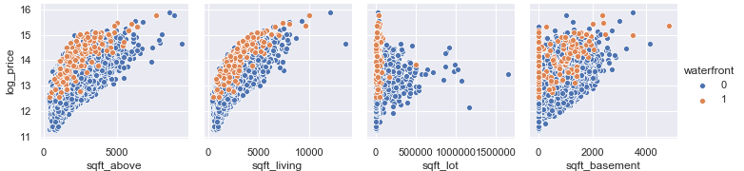
The size of the house (sqft_living) has the biggest impact on the Price

Slide 6
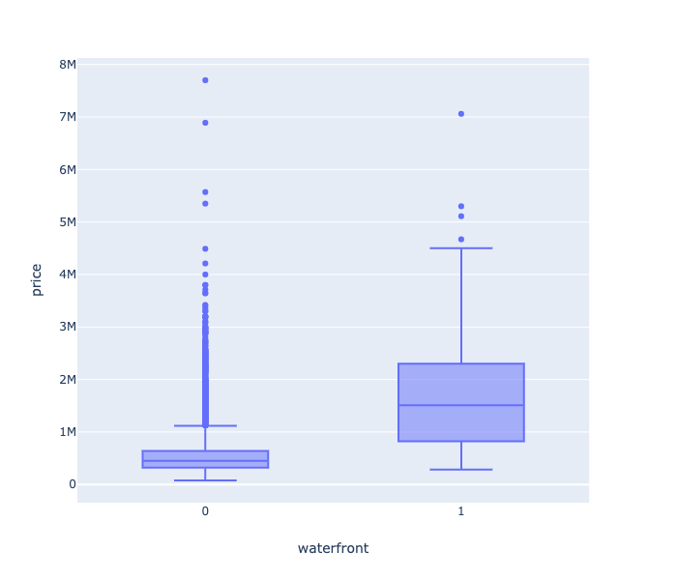
Waterfront Houses

Slide 7
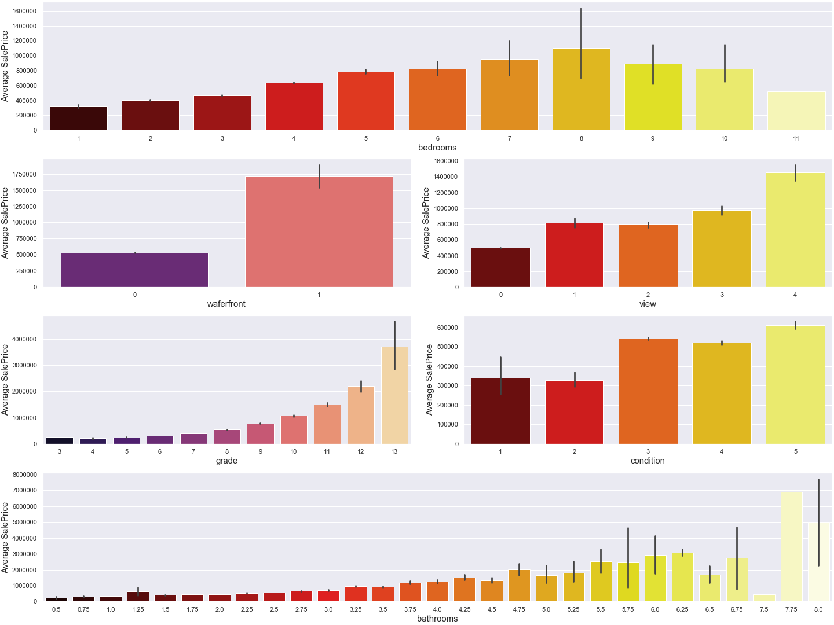
Which features of the house influence the price

Slide 8
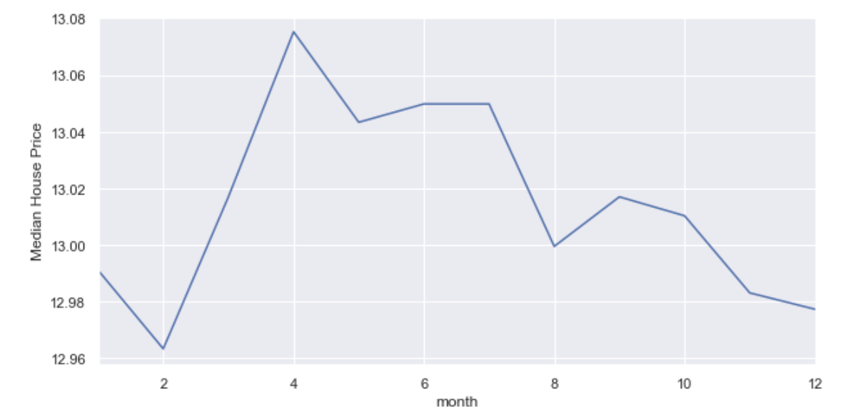
When to invest / sell ?

Slide 9
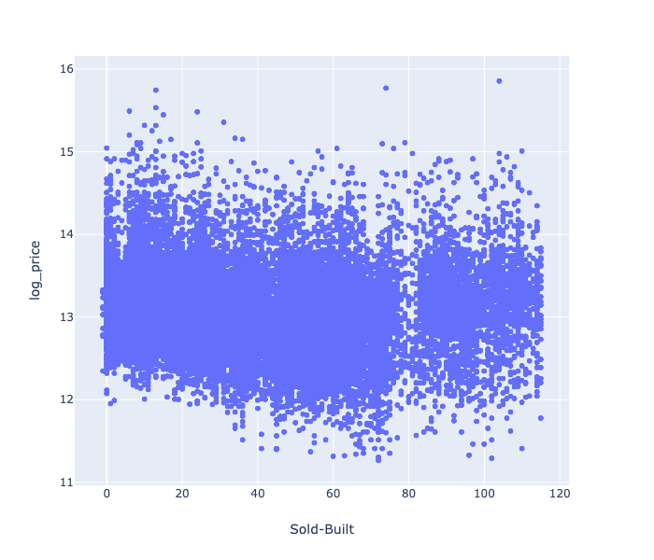
What about the age of the house ?

Slide 10
What do we recommend
Buying a house in the winter months appears to be cheaper
Selling a house between April and July increases the selling price
Buying cheaper waterfronts houses with little to medium view’s increases in value if the condition is increased → Renovations
The size of the house itself instead of the size of the lot sells at higher prices
Houses with a grade of 5-11 and a condition of 3-5 sell at higher prices

